Slide 1
Spend and Price Forecasting

Slide 2







Project Roadmap
Business Problem Identification
Understanding Data
Modelling & Evaluation
Methodology Overview
Analytics Problem Identification
Insights & Future Plans

Slide 3
1
Business Problem Identification

Slide 4

Business Problem
Remove uncertainty from future production costs by forecasting commodity prices and packaging material prices for the next 12 months

Slide 5



With our forecasted data, we reduce costs by optimizing our hedging strategy, adjusting budgeting and, negotiating better deals
Optimize hedging strategy and buying of future commodities
Allocate budget to maximize buying at lower prices
Negotiate deals to leverage predicted market prices

Slide 6
2
Methodology Overview

Slide 7
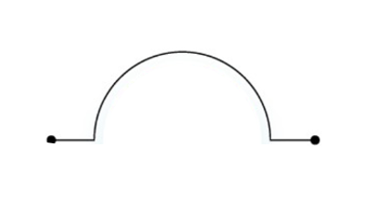





Framework
Data Preprocessing
Build Predictive Models
Predictions
Feature Engineering
Model Comparison

Slide 8






Understanding and Preprocessing Data
Data Preprocessing
Data Insights
Exploratory Data Analysis
Business and Industry Rules
Business Understanding
Anomaly
Treatment
Research Learnings
Feature Engineering
Transformation
Moving averages and expanding averages
Lag variables
Mapping raw material to different product types
Notes:
Thank you, Judy. Let's dive into the methodology we used for our forecasting model. Our journey began with a deep dive into our data. We meticulously cleaned and preprocessed it, ensuring it was ready for analysis. This step included handling anomalies, like filling in missing values with the median in our resin dataset, and removing extreme outliers from our spending data by focusing on data within a certain range of standard deviations from the mean.
We then explored the data, looking for patterns and seasonal trends, which helped us understand the underlying dynamics of the datasets. We also considered important business and industry factors that could affect our data, incorporating insights from our research.
Next, we moved on to feature engineering, where we enhanced our data with new variables we believed were crucial for our predictions. This included moving and expanding averages, lag variables, and linking specific spend forecast values to our resin dataset.

Slide 9
Modeling
Model Optimization
Commodity price modeling
Commodity Price
Prediction
Package Price
Prediction
Commodity price model selection
LSTM
GRU
ARIMA
Machine Learning
Machine Learning
Statistical
Package price modeling
Model Comparison & Evaluation
Package price model selection
RMSE – Root Mean Square Error MAPE – Mean Absolute Percentage Error
Notes:
With our data fully prepped, we turned our attention to building the prediction model. We experimented with various machine learning algorithms, such as LSTM and GRU, as well as statistical approaches like ARIMA, to forecast commodity prices. We adjusted parameters and rigorously compared models using metrics like RMSE and MAPE to select the most accurate one.
Finally, we applied these methodologies to predict resin prices, fine-tuning our process based on the outcomes and extending our predictions to unit prices.
In summary, our approach was thorough and iterative, ensuring that each step built on the previous one to enhance our model's accuracy and reliability.

Slide 10
3
Understanding Data

Slide 11




Data
Commodity Prices
Packaging Prices
Data is strictly time series
Data is cross sectional / time series
Distributed across different commodity types
Distributed on material group and number
Monthly market averages
Actual buying prices
Data unique for each commodity
Data unique across purchasing day and, material group etc.

Slide 12
4
Analytics Problem Identification

Slide 13





From Business to Analytics
Tableau for visualization dashboard
Using EDA to discover initial trends
Specify related variables to improve prediction accuracy
Python libraries to create predictive models

Slide 14





Analytical Problem
From knowing the data to generate analyticla problem
Is it time-series data?
Different in Time
Commodity is monthly data and spend with multiple entries in daily.
Does seasonality show in non-natural commodity?
Missing Data
Not all materials are purchased on daily basis.
What is the best fit model?
How to connect commodity price to package price prediction?
What is the relationship between commodity and package price?

Slide 15
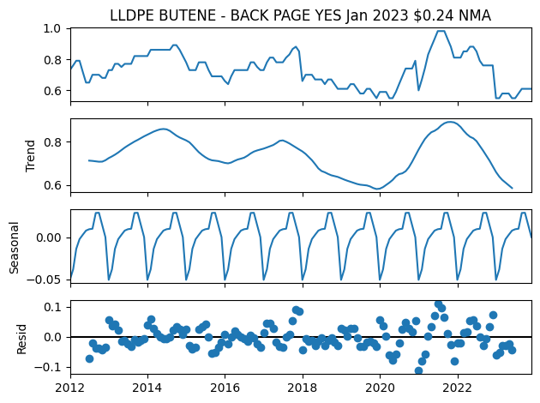
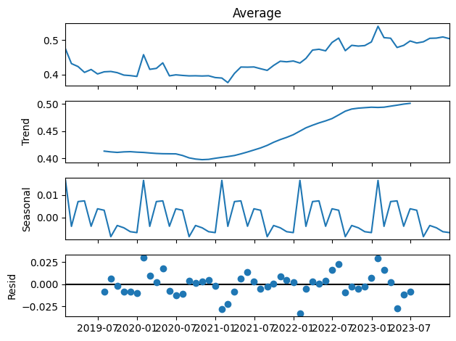
Seasonality
Proof of existance in commodity and unit price
Coclusion – seasonality exist for Reisn Price & $/UOM
Limitation – not yet discover pattern between commodity price and $/UOM
Kruskal-Wallis
Test Result
Period (month) | 3 | 6 | 12 | 18 | 24
Commodity | v | v | v | v | v
Pacakge Price | v | v | v | v | v

Slide 16
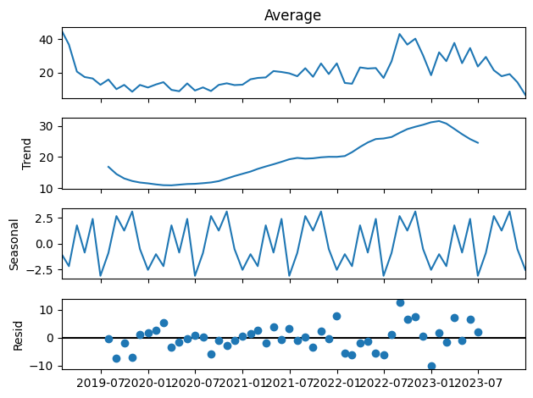
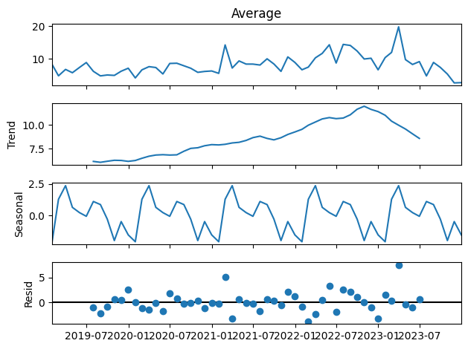
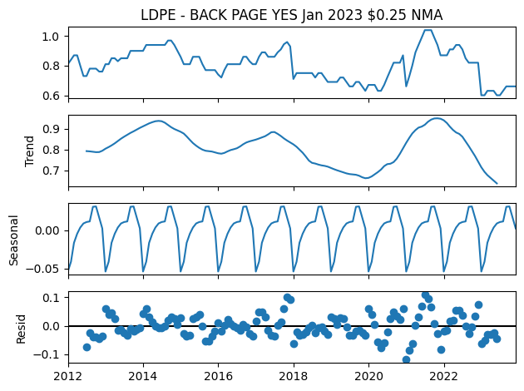
Seasonality
Similar pattern shown between same product or related commodity
Film-Forming Pln and Film-NonForming Pln both made up of LLDPE and LDPE

Slide 17
5
Modeling & Evaluation

Slide 18


General Model Concept
Commodity
Package
Data
Model
Prediction
Data
Model
Prediction
Data split: 80/20
Commodity: LLDPE
Material Group: Shrink Bag Bone-In
Model evaluation: RMSE, MAPE
Data size: 144 for commodity & 60 for package price at most

Slide 19
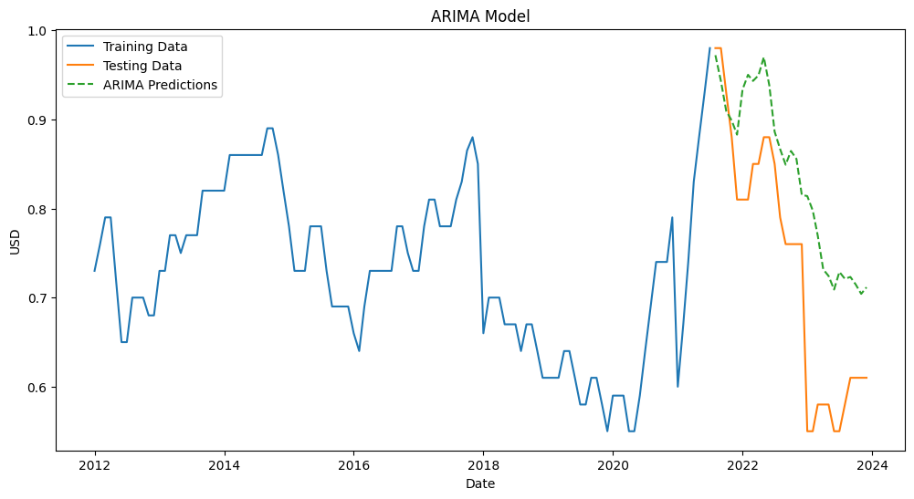
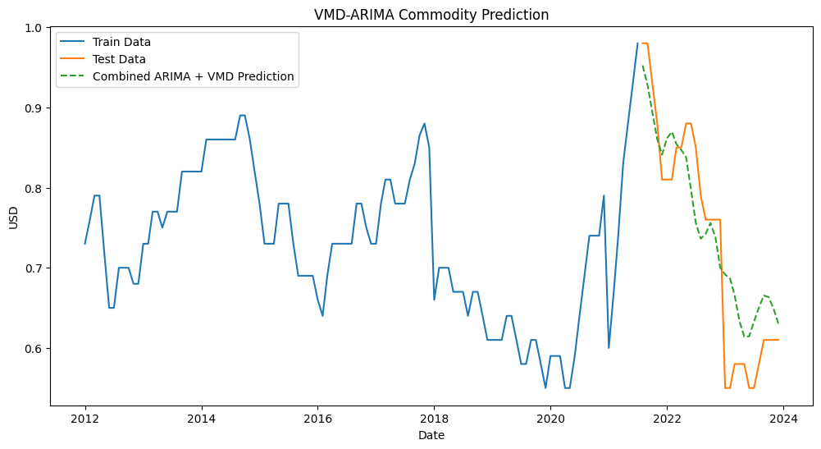

Commodity
ARIMA
VMD-ARIMA
RMSE
MAPE
RMSE
MAPE
0.12
16.53%
0.06
7.76%

Slide 20
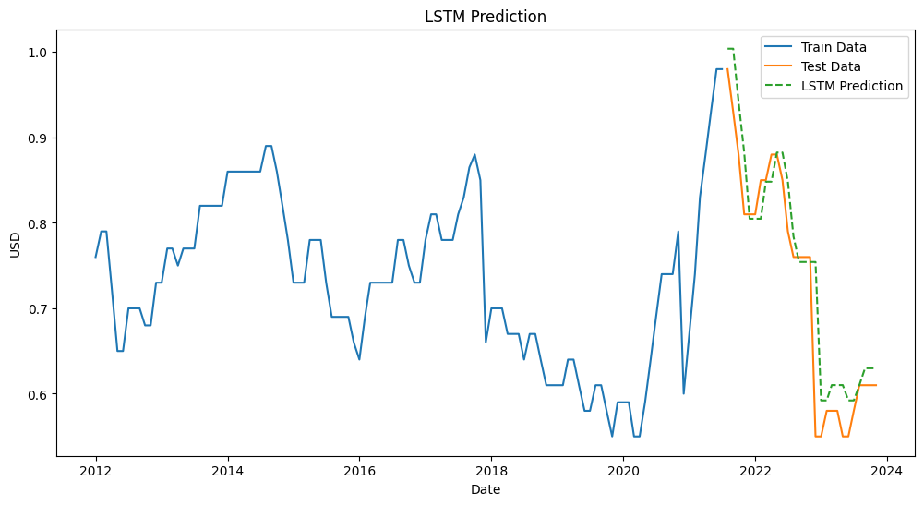
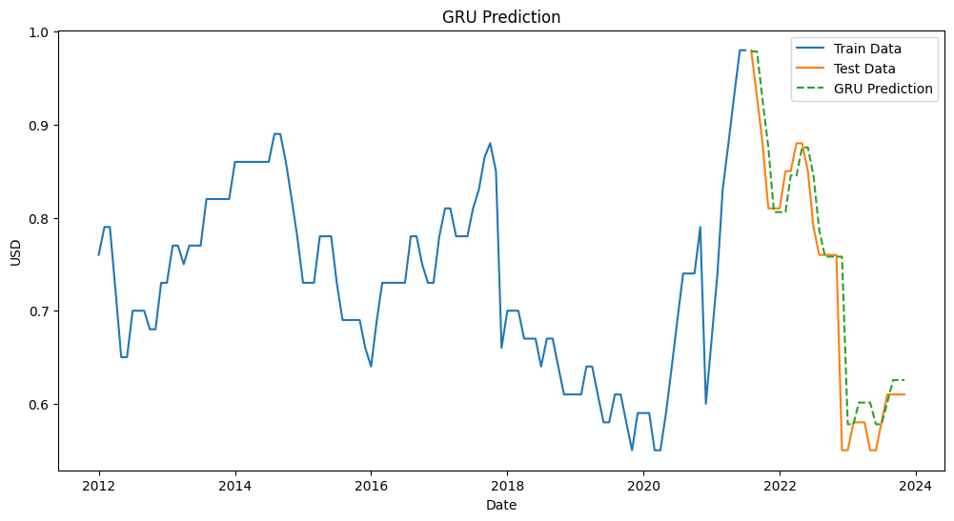
Commodity
LSTM
GRU
RMSE
MAPE
RMSE
MAPE
0.05
5.05%
0.04
4.23%

Slide 21
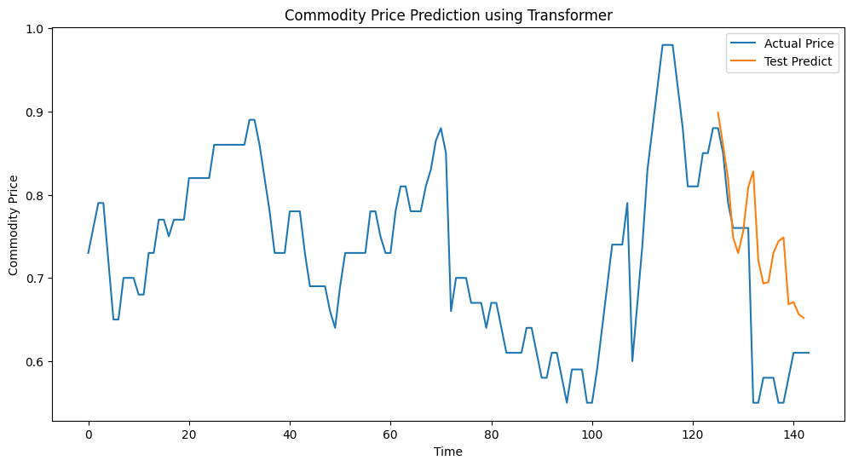
Commodity
TRANSFORMER
Quick Note:
ML approach generally perform better with MAPE around 5%. Pure statistical is around 8%.
Transformer require more datapoint to be more robust.
LSTM require 2 layers, GRU 1 layer. Performance depends on different target.
RMSE
MAPE
0.13
17.81%

Slide 22
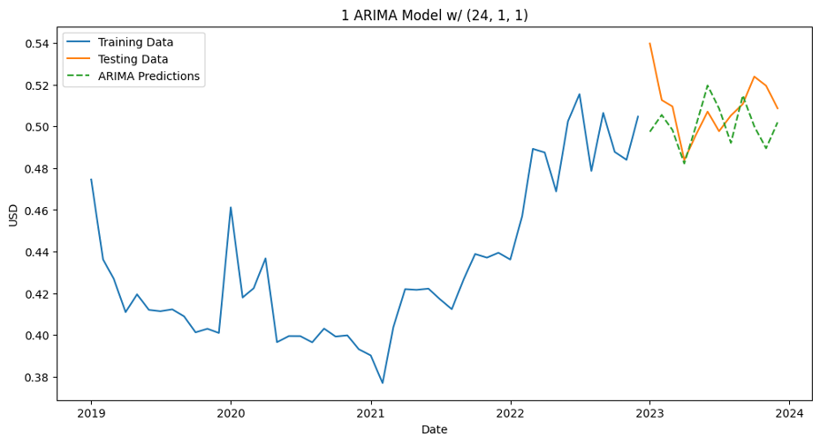
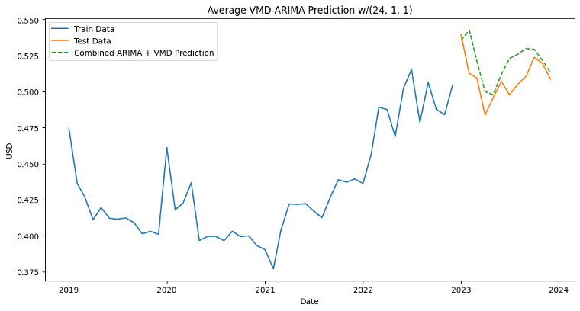
$/UOM – Material Group
Model: ARIMA,VMD-ARIMA, LSTM, GRU
Data: Monthly maximum, minimum, average of the whole material group
RMSE
MAPE
RMSE
MAPE
0.0018
2.69%
0.0015
2.43%

Slide 23
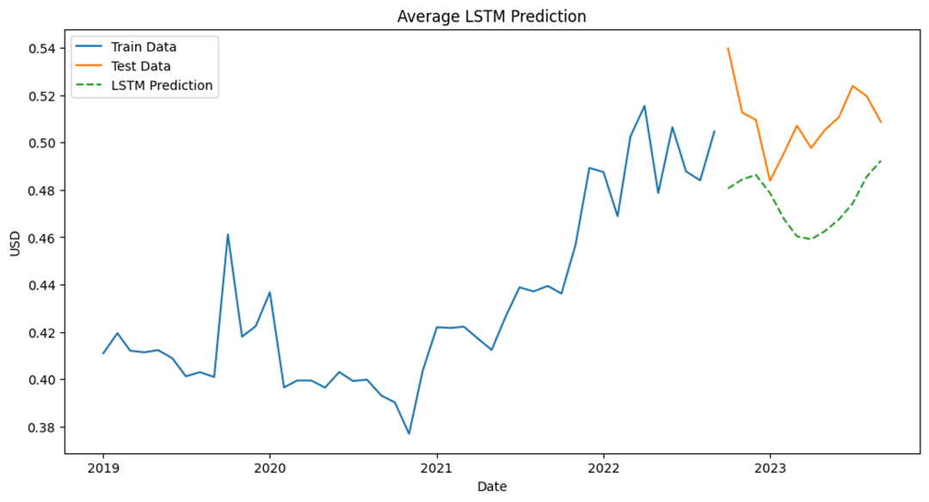
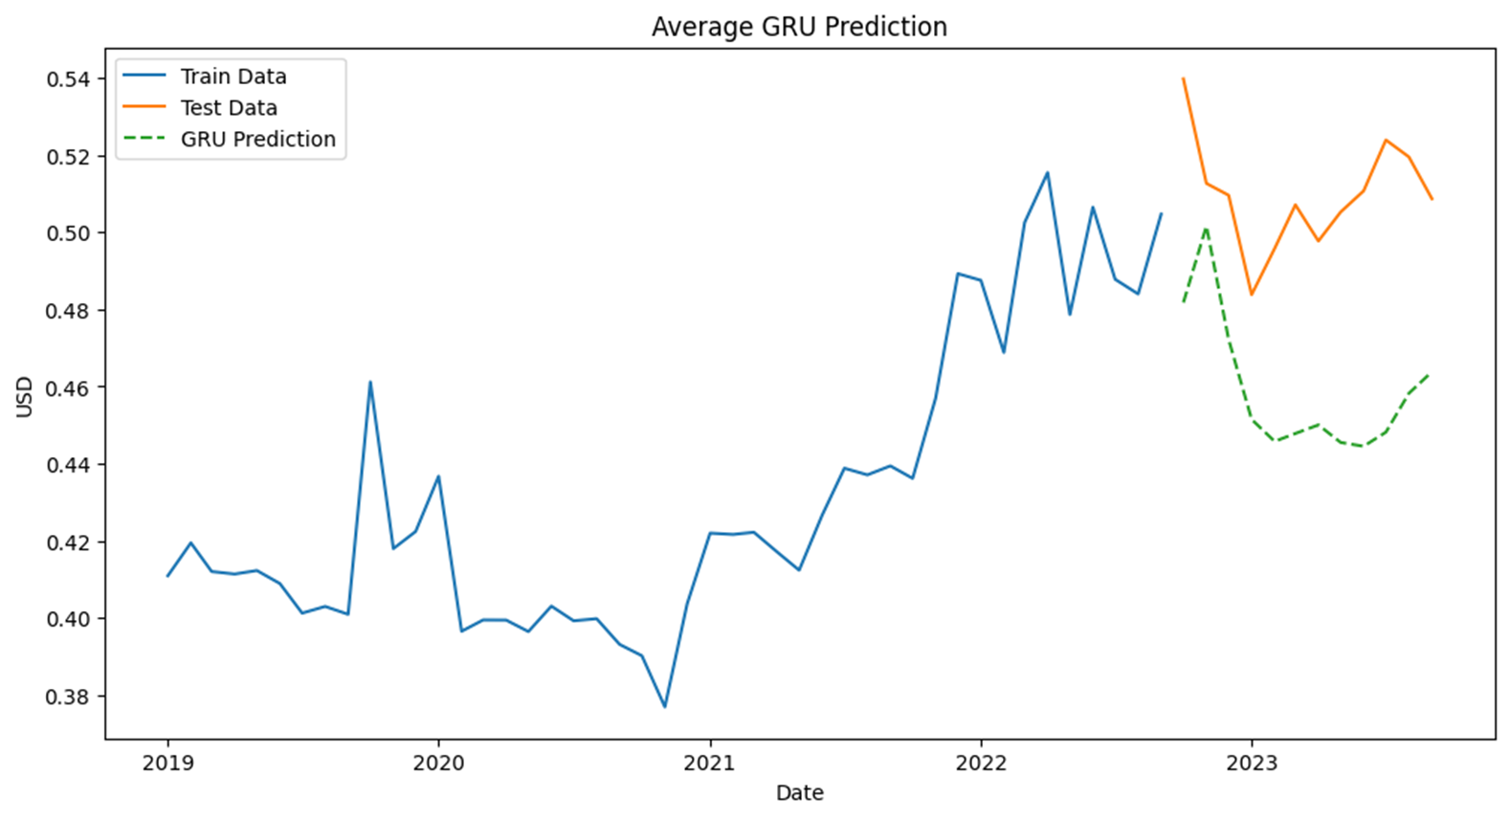
$/UOM – Material Group
Model: ARIMA,VMD-ARIMA, LSTM, GRU
Data: Monthly maximum, minimum, average of the whole material group
RMSE
MAPE
RMSE
MAPE
0.0379
6.73%
0.0529
9.92%

Slide 24

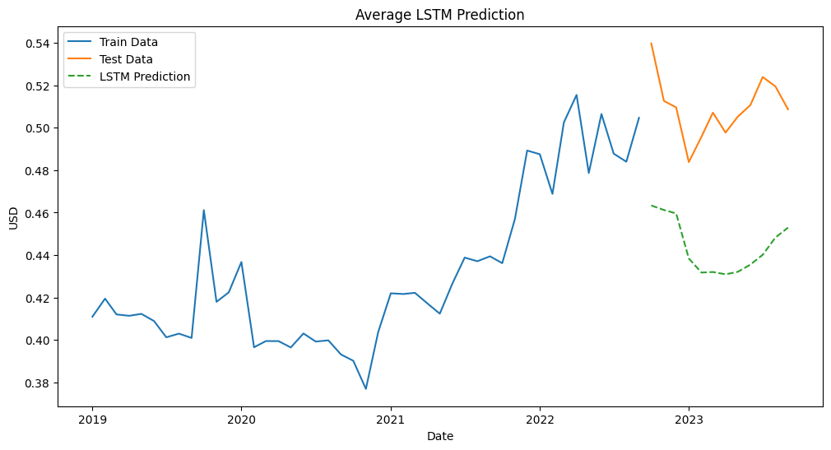
$/UOM – Material Group
Unstable performance for machine learning approach
Quick Note:
GRU |  | LSTM
RMSE | MAPE | RMSE | MAPE
0.059468 | 11.382 | 0.045439 | 8.24477
0.052928 | 9.8377 | 0.037499 | 6.73587
0.052875 | 9.927634 | 0.066675 | 12.85483
0.045789 | 8.374654 | 0.068783 | 13.28263
Lack of datapoint and rather flat fluctuation (less noisy)

Slide 25
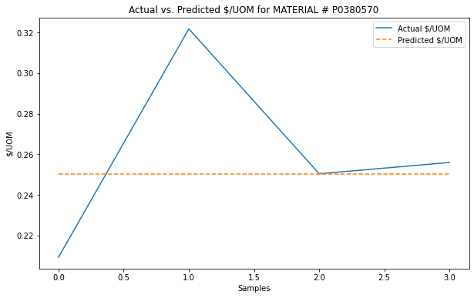
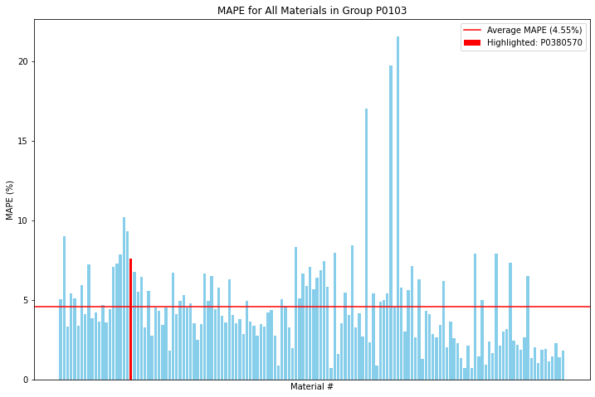
$/UOM – Material Number
RMSE
MAPE
MAPE
0.0234
7.60%
4.55%
Notes:
After exploring our model's performance at a broader material group level, we'll now look at how it operates on a more granular scale - at the level of individual material numbers. Here, we faced a unique challenge: the data was sporadic and lacked the consistent timeline necessary for time series forecasting.
To navigate this, we turned to non-sequential machine learning techniques, allowing us to approach each material individually. For every material number, we developed a dedicated model. This tailored approach enabled us to evaluate the models' performance more accurately, using metrics like RMSE and MAPE.
It's important to note why we didn't rely on an average RMSE for the entire group. Given the diversity and inconsistency in the data, averaging RMSE wouldn't provide a clear picture. Instead, we focused on MAPE to gauge the overall group's performance.
The results were encouraging. We achieved a MAPE of less than 5% across the group. This level of accuracy is particularly noteworthy considering the limited data points available for some materials. It's a testament to the effectiveness of our tailored, non-sequential approach in handling predictions at the material number level.

Slide 26
Final Prediction Process Map
Package
Commodity
Data
VMD-ARIMA
Prediction
Package
Data
LSTM/GRU
Prediction
Data
LSTM
Prediction
5/3/2024
26

Slide 27
6
Insights & Future Plans

Slide 28
Insights
Although the seasonality of the $/UOM is most significant at 12- or 18-month, the $/UOM model performs best when look back on 3 months, fitting the business insight.
3-year cyclical in commodity price
ML approach perform better with noisy time-series data and request more data point.
Commodity – GRU & LSTM
$/UOM – VMD-ARIMA & LSTM

Slide 29
Future Plan
Daily or weekly $/UOM model instead monthly, if we have daily/weekly commodity price
More related varaibles should be consider, to enhance the performance of ML
Including location, vendors
Different model for each commodity/ material number

Slide 30
Thank You

